Slide 1
Lecture 10
Operating Systems (COMP1562)

Slide 2

Introduction to…
…system administration
Mariusz Pelc © 2012/2013
(with support from Dr Kevin McManus and Dr Cos Ierotheou)

Slide 3
Where to start?
Linux system administration comprises of many activities, which include:
Users & groups management
Software management
Network services management
Security management
Some of the above activities will require using dedicated administration tools (system commands), but there are numerous system mechanisms which can be controlled by special configuration files. In such a case all one would need to achieve requested system behaviour is to identify the files and alter it appropriately.
Mariusz Pelc © 2012/2013
(with support from Dr Kevin McManus and Dr Cos Ierotheou)

Slide 4
Where to start?
Most of the configuration files we will be talking about today is located in the /etc directory or one of its subdirectories. Taking into account the number of files it is impossible to show how to use them, but some interesting ones will definitely be presented today, including:
/etc/aliases, /etc/aliases.db
/etc/anacrontab
/etc/bashrc
/etc/cron.hourly,/etc/cron.daily, /etc/cron.weekly, /etc/cron.monthly
/etc/fstab
/etc/group, /etc/passwd, /etc/shadow
Mariusz Pelc © 2012/2013
(with support from Dr Kevin McManus and Dr Cos Ierotheou)

Slide 5
Where to start?
/etc/hosts
/etc/hosts.allow, /etc/hosts.deny
/etc/inittab
/etc/login.defs
/etc/protocols, /etc/services
/etc/resolv.conf
/etc/rsyslog.conf
/etc/securetty
/etc/sudoers
/etc/security/limits.conf
Mariusz Pelc © 2012/2013
(with support from Dr Kevin McManus and Dr Cos Ierotheou)

Slide 6
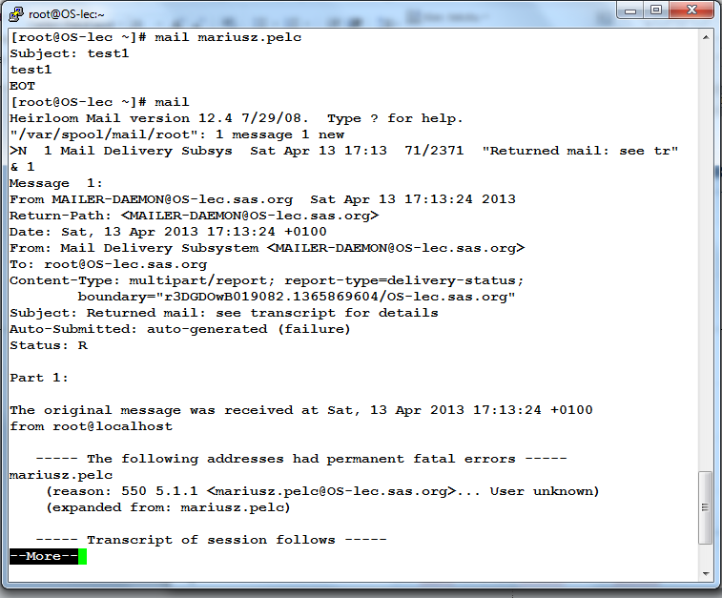

/etc/aliases, /etc/aliases.db
Mariusz Pelc © 2012/2013
(with support from Dr Kevin McManus and Dr Cos Ierotheou)

Slide 7
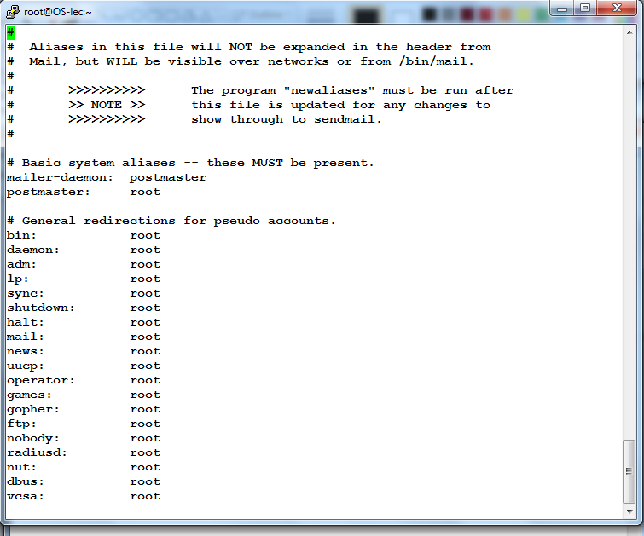
/etc/aliases, /etc/aliases.db
Mariusz Pelc © 2012/2013
(with support from Dr Kevin McManus and Dr Cos Ierotheou)

Slide 8
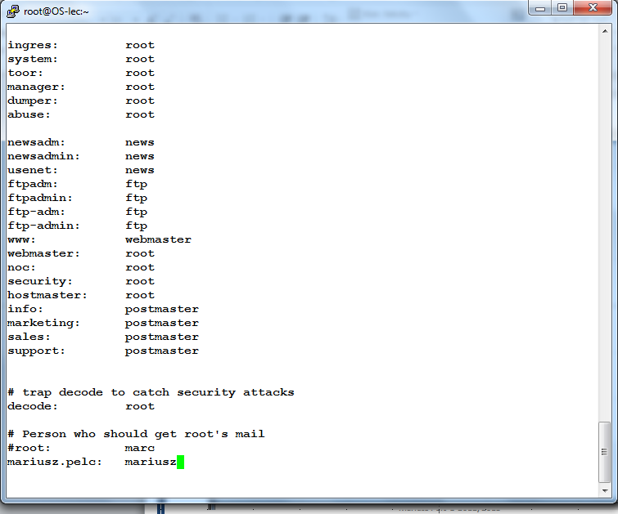
/etc/aliases, /etc/aliases.db
Mariusz Pelc © 2012/2013
(with support from Dr Kevin McManus and Dr Cos Ierotheou)

Slide 9
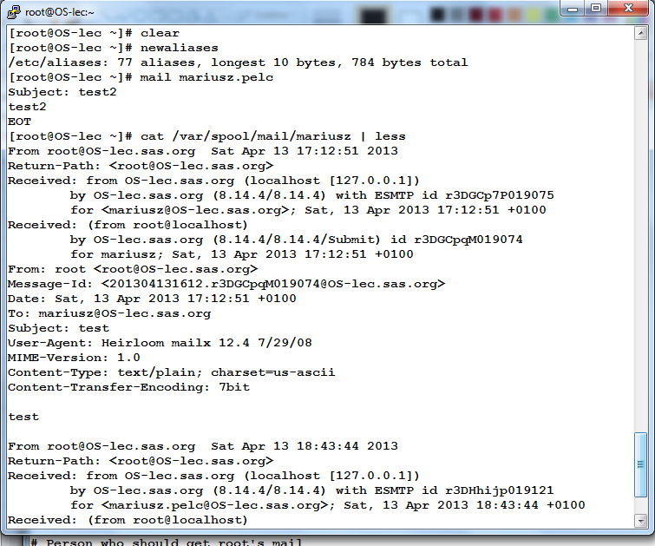
/etc/aliases, /etc/aliases.db
Mariusz Pelc © 2012/2013
(with support from Dr Kevin McManus and Dr Cos Ierotheou)

Slide 10
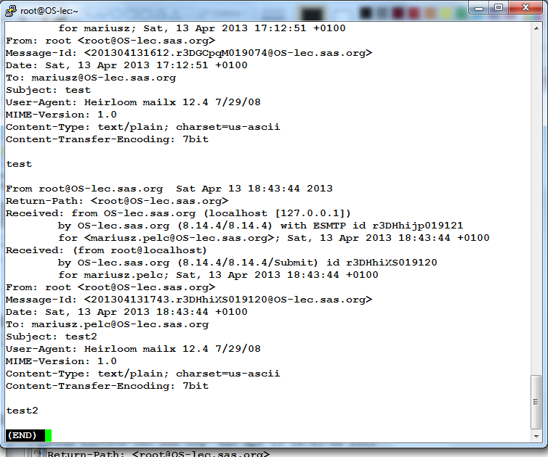
/etc/aliases, /etc/aliases.db
Mariusz Pelc © 2012/2013
(with support from Dr Kevin McManus and Dr Cos Ierotheou)

Slide 11
/etc/anacrontab
The /etc/anacrontab file allows system admin to define some tasks that are to be executed at the system start. Every entry in the /etc/anacrontab file is of format:
Period_days Delay Task_ID command
For example
2 5 SCP scp /etc/passwd m.pelc@gre.ac.uk
The above entry will trigger copying the /etc/passwd file to another machine in case the system was restarted at least 2 days ago. The delay once it is determined that the command should be executed will be 5 seconds.
Mariusz Pelc © 2012/2013
(with support from Dr Kevin McManus and Dr Cos Ierotheou)

Slide 12
/etc/anacrontab
Other files that are used to make the mechanism work are:
/var/spool/anacron/* - contains timestamp files
/etc/cron.hourly - used to turn on / off the anacron mechanism
/etc/cron.hourly/0anacron - used to trigger anacron to start
Mariusz Pelc © 2012/2013
(with support from Dr Kevin McManus and Dr Cos Ierotheou)

Slide 13
/etc/bashrc
The /etc/bashrc file defines certain system properties (mostly via system variables). The file is included in users’ .bashrc files which guarantees that each user will have certain system variables defined and ready to use. The file defines for example the PATH variable (system paths allowing users to use comands without the need of using full paths) or PS1 variable (defining the command prompt look). And many others.
Mariusz Pelc © 2012/2013
(with support from Dr Kevin McManus and Dr Cos Ierotheou)

Slide 14
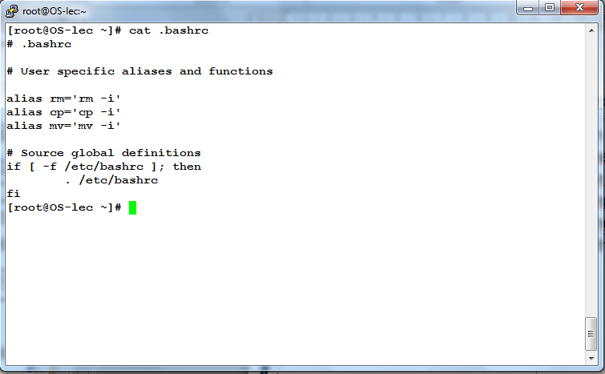
/etc/bashrc
Mariusz Pelc © 2012/2013
(with support from Dr Kevin McManus and Dr Cos Ierotheou)

Slide 15
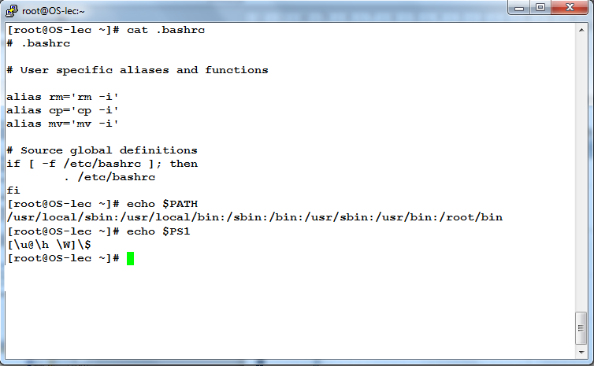
/etc/bashrc
Mariusz Pelc © 2012/2013
(with support from Dr Kevin McManus and Dr Cos Ierotheou)

Slide 16
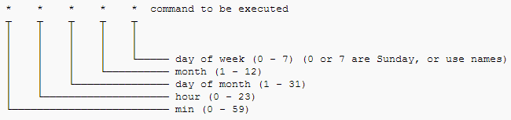
/etc/cron.*
The /etc/cron.* directories are the most convenient way for setting some periodic / cyclic tasks to be executed by a designadet crond daemon every hour, day, week or month. All the system admin needs to do in order to for example backup system every day is to place the backup script into the /etc/cron.daily directory and in the script he should put commands that will get the backup work done.
The crond job should be specified in the below format:
Mariusz Pelc © 2012/2013
(with support from Dr Kevin McManus and Dr Cos Ierotheou)

Slide 17
/etc/cron.*
Examples
The following line specifies that the Apache error log is to be cleared at one minute past midnight (00:01) of every day of the month, of every day of the week, assuming that the default shell for the cron user is Bourne shell compliant:
1 0 * * * printf > /var/log/apache/error_log
The following line causes the user program test.pl – ostensibly a Perl script – to be run every two hours, namely at midnight, 2am, 4am, 6am, 8am, and so on:
0 */2 * * * /home/username/test.pl
Mariusz Pelc © 2012/2013
(with support from Dr Kevin McManus and Dr Cos Ierotheou)

Slide 18
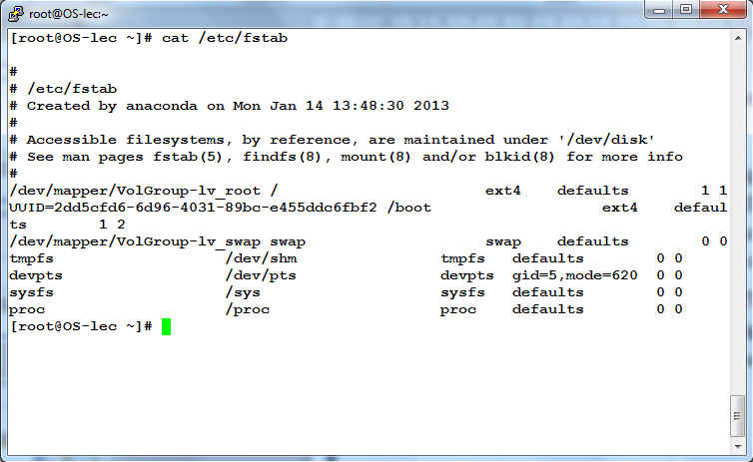
/etc/fstab
Mariusz Pelc © 2012/2013
(with support from Dr Kevin McManus and Dr Cos Ierotheou)

Slide 19
/etc/group, /etc/passwd, /etc/shadow
The /etc/group, /etc/passwd and /etc/shadow files are all used to manage system users and groups. The /etc/group file is used to define system groups, the /etc/passwd file is used to store information about users (their names, Ids, initial groups, home directory or default shell) whilst the /etc/shadow file is used to store users’ passwords and account aging information.
LIFE DEMO
Mariusz Pelc © 2012/2013
(with support from Dr Kevin McManus and Dr Cos Ierotheou)

Slide 20
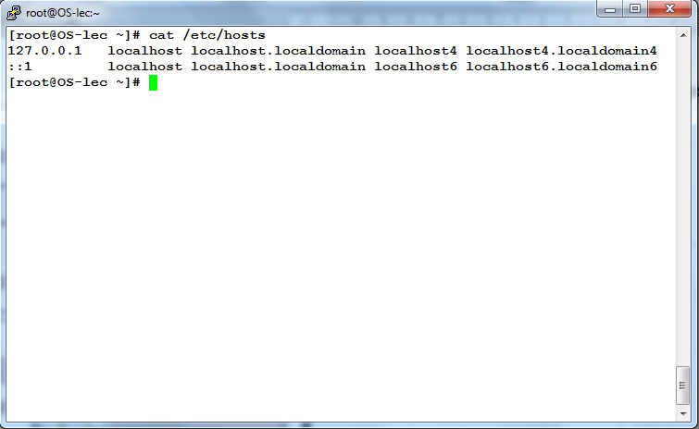
/etc/hosts
The /etc/hosts file is used to define computers’ names and IP numbers.
Mariusz Pelc © 2012/2013
(with support from Dr Kevin McManus and Dr Cos Ierotheou)

Slide 21
/etc/hosts.allow and /etc/hosts.deny
The /etc/hosts.* files are used to configre TCPWRAPPERS mechanism which allows to specify which services can be used and from which network locations. This mechanism works apart from typical IP filtering mechanism.
LIFE DEMO
Mariusz Pelc © 2012/2013
(with support from Dr Kevin McManus and Dr Cos Ierotheou)

Slide 22
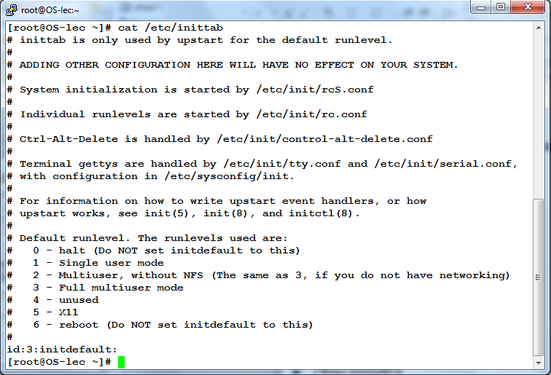
/etc/inittab
The /etc/inittab file defines system runlevels.
Mariusz Pelc © 2012/2013
(with support from Dr Kevin McManus and Dr Cos Ierotheou)

Slide 23
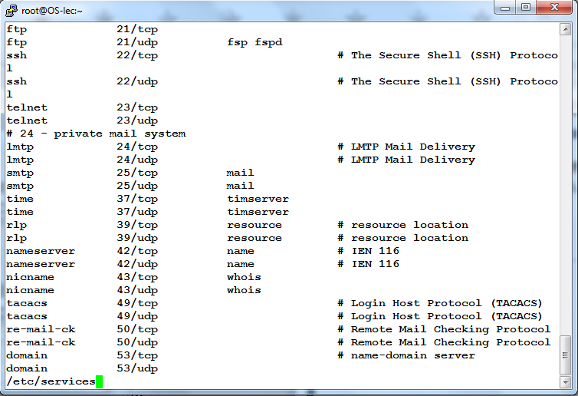
/etc/protocols, /etc/services
First defines protocols numbers, second defines friendly names for internet services (such as ftp, http, smtp, etc.).
Mariusz Pelc © 2012/2013
(with support from Dr Kevin McManus and Dr Cos Ierotheou)

Slide 24
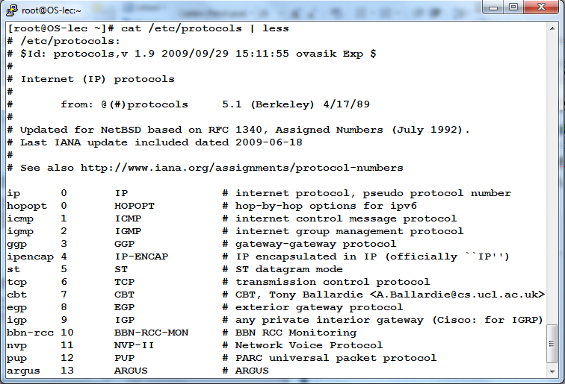
/etc/protocols, /etc/services
First defines protocols numbers, second defines friendly names for internet services (such as ftp, http, smtp, etc.).
Mariusz Pelc © 2012/2013
(with support from Dr Kevin McManus and Dr Cos Ierotheou)

Slide 25
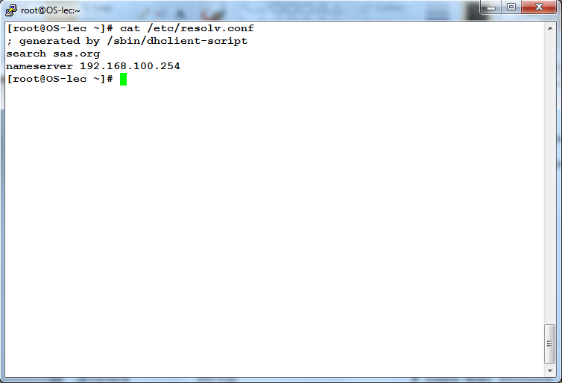
/etc/resolv.conf
The /etc/resolv.conf file defines default search domain and nameservers.
Mariusz Pelc © 2012/2013
(with support from Dr Kevin McManus and Dr Cos Ierotheou)

Slide 26
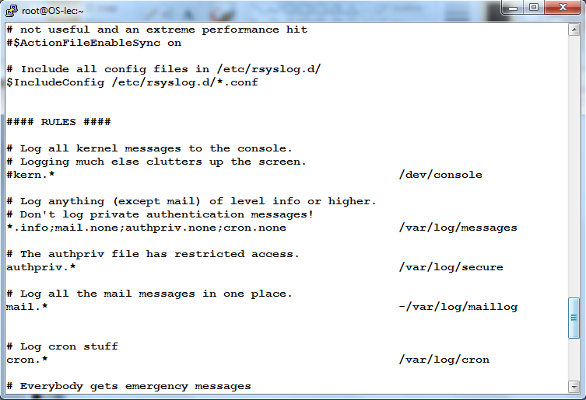
/etc/rsyslog.conf
The /etc/rsyslog.conf conf file system logging (audit) preferences.
Mariusz Pelc © 2012/2013
(with support from Dr Kevin McManus and Dr Cos Ierotheou)

Slide 27
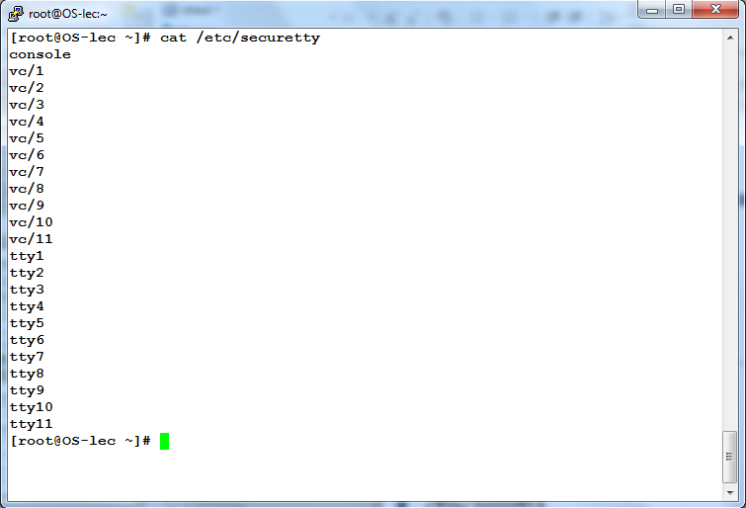
/etc/securetty
The /etc/securetty defines consols the root user can use to log in.
Mariusz Pelc © 2012/2013
(with support from Dr Kevin McManus and Dr Cos Ierotheou)

Slide 28
/etc/sudoers
The /etc/sudoers file is used to delegate part of the admin responsibility to less priviledged users.
LIFE DEMO
Mariusz Pelc © 2012/2013
(with support from Dr Kevin McManus and Dr Cos Ierotheou)

Slide 29
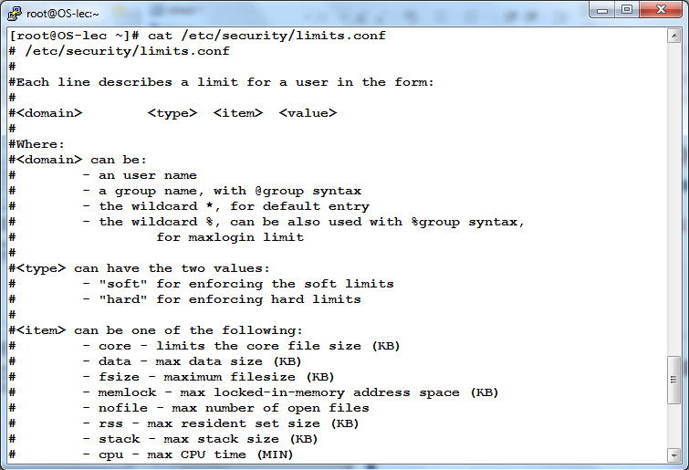
/etc/security/limits.conf
The /etc/security/limits.conf file is used to define limits for systems resources.
Mariusz Pelc © 2012/2013
(with support from Dr Kevin McManus and Dr Cos Ierotheou)

Slide 30
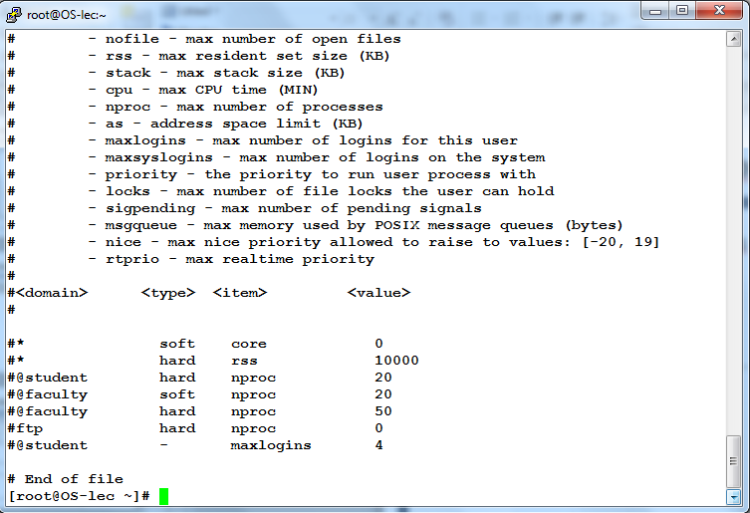
/etc/security/limits.conf
The /etc/security/limits.conf file is used to define limits for systems resources.
Mariusz Pelc © 2012/2013
(with support from Dr Kevin McManus and Dr Cos Ierotheou)

Slide 31
/etc/security/limits.conf
IF TIME PERMITS THERE WILL BE ANOTHER DEMO SHOWING NICE FEATURES OF LINUX FEDORA DISTRIBUTION
Mariusz Pelc © 2012/2013
(with support from Dr Kevin McManus and Dr Cos Ierotheou)

